Slide 1
6th Grade Course Selection
For Current
5th Grade Students
For 2024-2025

Slide 2
DIRECTIONS
Read over 6th grade course descriptions and information located in the 2024-2025 Junior High Course Selection Guide with your parent/guardian. Can be found on MJH Webpage/Counselor’s Corner.
Carefully select LEVEL or ADVANCED/ACCELERATED for RLA, MATH, SCI, & SOC. ST.
(If any ADV/ACC course is selected, you MUST complete the BACK of the form.)
3. Select 1 PE option.
4. RANK your elective choices by numbering 1-9 in order of your favorites. (1=most favorite)
5. Student & Parent/Guardian MUST sign bottom of form

Slide 3
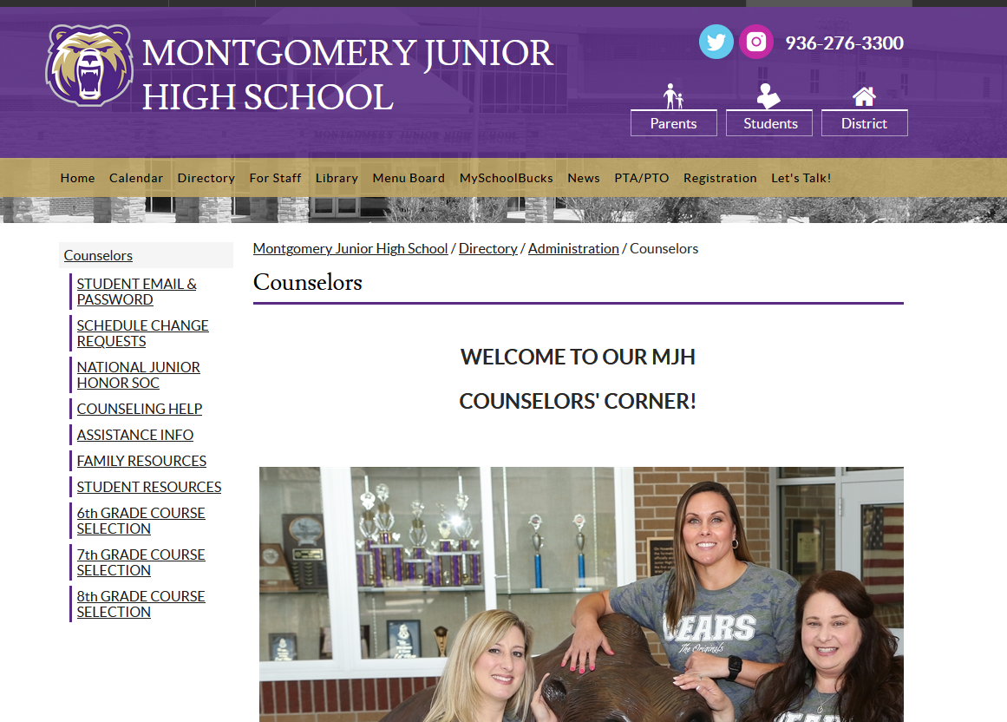
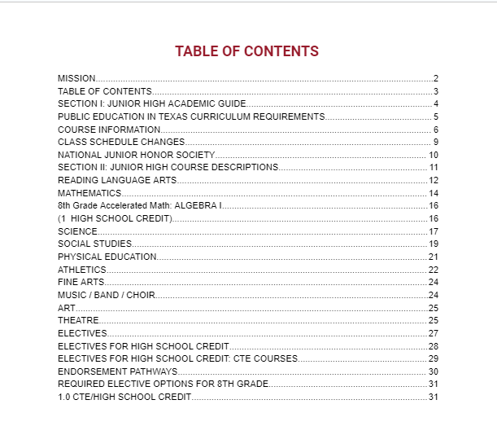
MJH 24-25 Course Selection Guide
All 6th Grade course information and course descriptions can be found
ON-LINE:
MJH school web page
Student Tab
Counselor’s Corner
Course Selection Information Tab

Slide 4
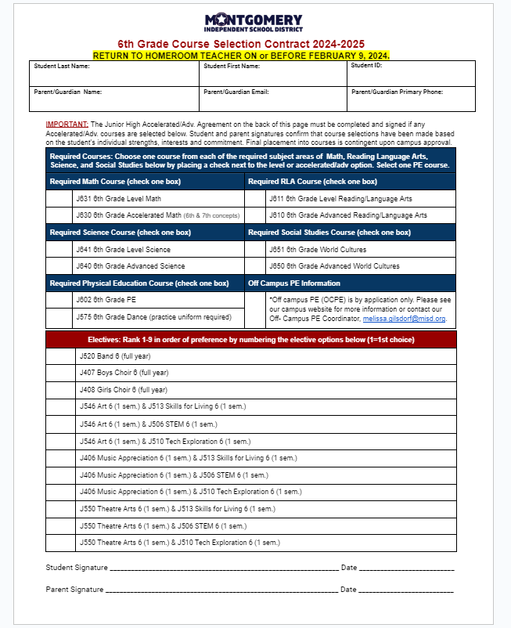
Students should have one item:
6th Grade Course Selection Contract 2024-2025
1

Slide 5
REMINDER: Complete the TOP Section of Course Selection Contract NEATLY.
DUE DATE ALERT:
Friday, FEB. 9

Slide 6
You will take 4 Core Classes: Reading Language Arts (RLA)-2 periods Math- 2 periods Science- 1 period Social Studies- 1 period

Slide 7
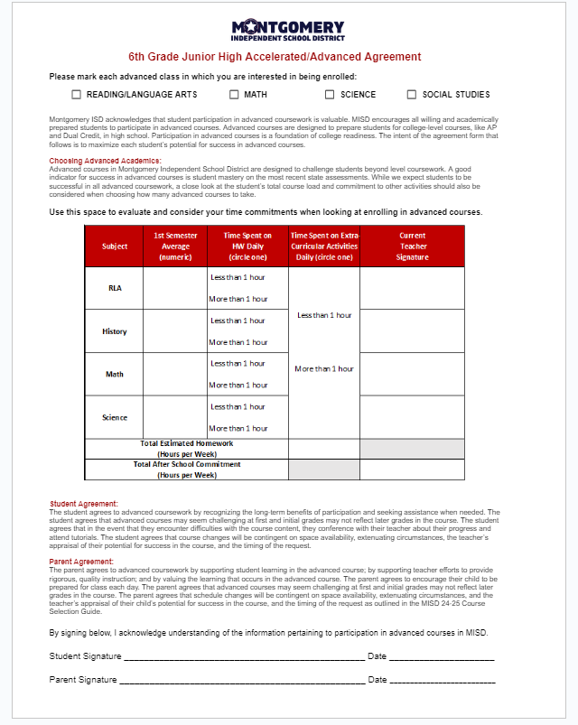
Students have the option of selecting
Level or Advanced/
Accelerated
for each Class
IMPORTANT:
If you choose at least
one adv./accel. class,
you MUST complete the BACK
of the Course Form.

Slide 8
ADVANCED Classes:
are for
Willing
and
Academically Prepared
Students

Slide 9
ADVANCED Classes:
Prepare students for
college-level courses in the future.
Challenge students beyond
level course work.
Accelerated Math is accelerated and covers
all 6th and most of 7th grade material.

Slide 10
In ADVANCED Classes:
Students are expected to seek help when needed by conferencing with teachers and attending tutorials.
Students initial grades may not reflect later grades.
Students may change to a level course at designated times in the year.

Slide 11
PHYSICAL EDUCATION
ALL 6TH GRADE STUDENTS
MUST
PARTICIPATE IN A
PHYSICAL EDUCATION (PE) ELECTIVE!

Slide 12
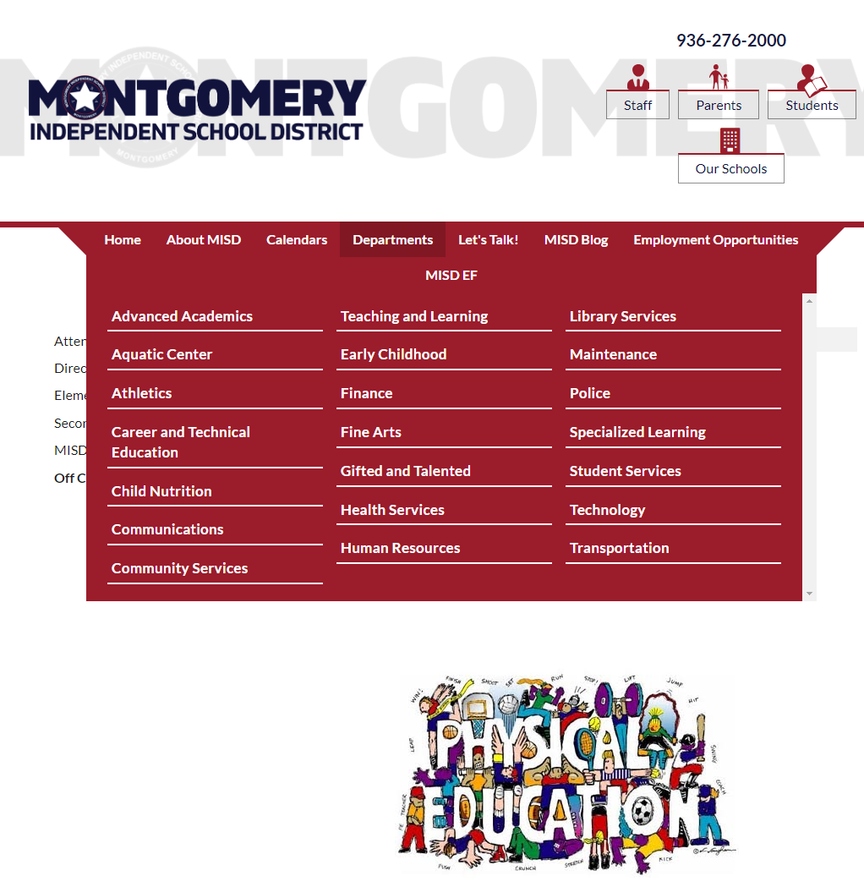
PE Choices
REGULAR PE: Team Sports/Fun Games: FOR ALL
DANCE: Learn dance team
techniques and performance showmanship. (Dance uniform purchase required.)
*OFF CAMPUS PE: Application on
MISD webpage. Approval required.

Slide 13
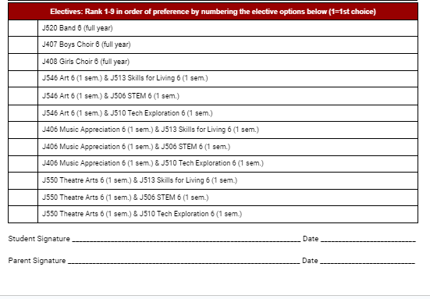
Let’s Talk About Choosing ELECTIVES:
Students will need to take a Fine Arts course
in either 6th, 7th, or 8th Grade.
Fine Arts Courses: Band, Choir, Art, Theatre, or Music Appreciation
Band & Choir are FULL Year Other Electives are 1 Semester
You will have ONE FULL YEAR
or
TWO SEMESTER electives in your schedule this year.
Semester electives are PAIRED.

Slide 14
6th Grade ELECTIVES:
BAND: PLAY an INSTRUMENT
CHOIR: SING
ART: Create ARTWORK
MUSIC APPRECIATION: MUSIC for everyone
THEATRE ARTS: ACTING
SKILLS for LIVING: LIFE LESSONS
STEM LAB: BUILDING & PROGRAMMING
TECH EXPLORATIONS: MICROSOFT OFFICE APPS

Slide 15
First 6th Grade Assignment:
Make sure you discuss & complete the Course Contract Form at home with your parent/guardian.
(Form MUST have signatures before you can turn it in.)
If taking any ADVANCED/ACCELERATED course: Complete the back page of the form. If not, leave it BLANK.
Turn in form to your HOMEROOM
teacher ON or BEFORE
Friday, Feb. 9.

